Slide 1
Bringing Real World Assets On-Chain: How Traditional Finance Meets Decentralised Systems
Fahd
Co Authors <Placeholder>

Slide 2
Why Real-World Asset (RWA) Tokenisation Matters
Real-World Asset (RWA) Tokenisation transforms physical/financial assets into blockchain-based representations.
Enables fractional ownership, programmability, and liquidity.
Market projected to reach multi-trillion USD by 2030.
Challenge: bridging trust, legality, and compliance between TradFi and DeFi.

Slide 4
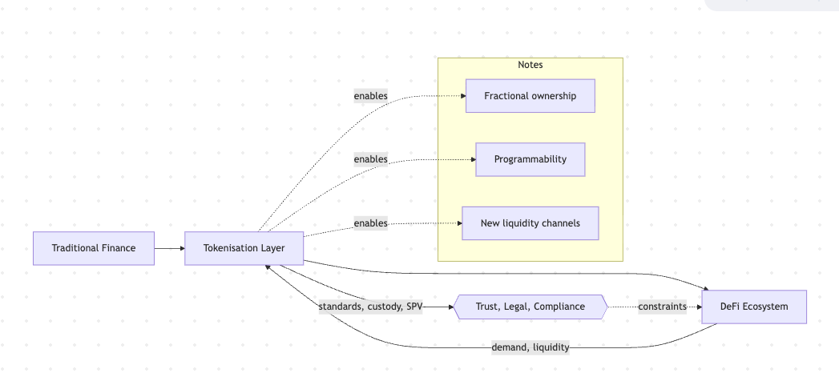

Slide 5
Problem Landscape -Challenges in Bringing Real-World Assets On-Chain
Fragmented legal and regulatory environments across jurisdictions.
Lack of trusted verification for off-chain assets.
Limited interoperability between DeFi and institutional systems.
Absence of a unified compliance enforcement model.

Slide 6
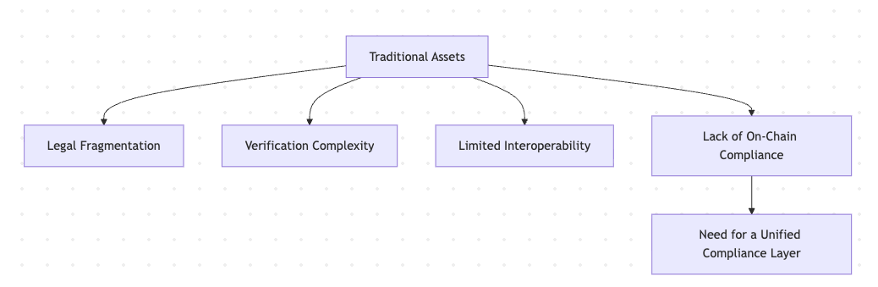

Slide 7
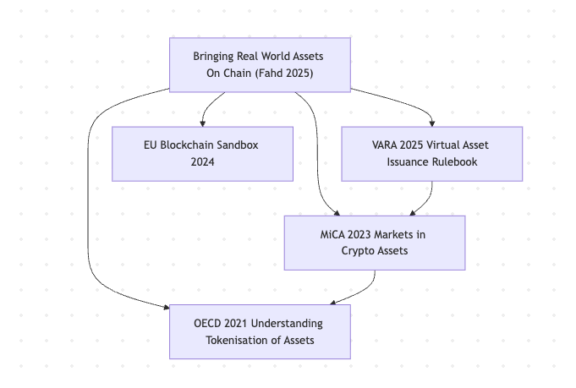

Slide 8
Literature and Gap (Why Compliance Matters?)
Reviewed literature: Cong et al. (2021), Ganne (2019), OECD (2021), WEF (2023), Katten (2025).
Case studies: MakerDAO, Centrifuge, Goldfinch, Maple Finance.
Gaps Identified:
Fragmented jurisdictional regulations.
Lack of unified standards (ERC-1400, ERC-3643, MiCA).
Compliance usually off-chain → should be protocol-native.

Slide 9
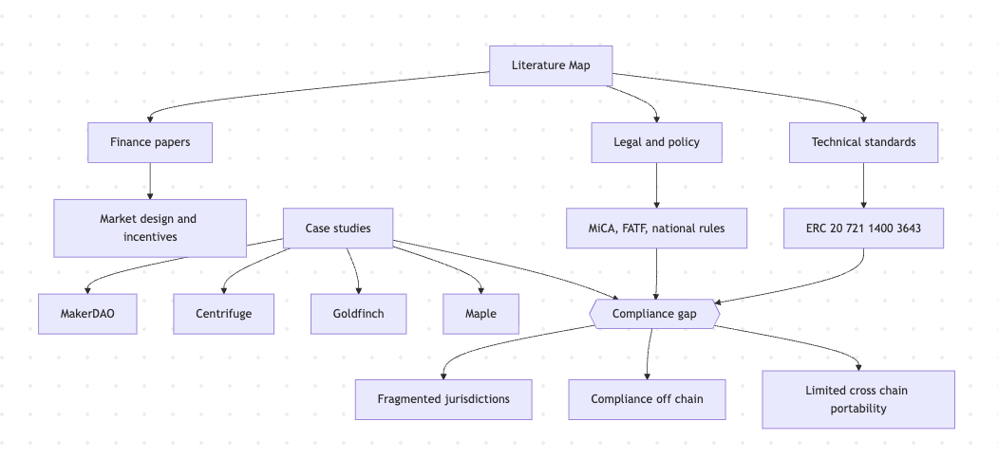

Slide 10
Research Phase 1 - Five focus pillars
Technical Infrastructure
Legal and Regulatory Frameworks
Compliance and Standards
DeFi Integration Models
Institutional Adoption

Slide 11
Research Direction: Composable Compliance Architecture
Concept: Compliance logic embedded directly at protocol level.
Structure layers:
Real-World Asset
Legal Wrapper / SPV
Smart Contract Layer
Protocol-Level Compliance Engine
DeFi & Institutional Integration

Slide 12
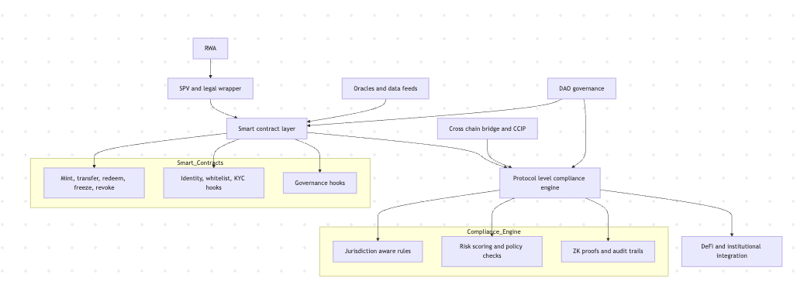

Slide 13
Key Findings and Future Work
Standards + Regulation alignment (MiCA, ISO, FATF).
Institutional infrastructure (MakerDAO RWA Foundation, Fireblocks, Anchorage).
Emerging tech: ZK proofs, cross-chain compliance, real-time auditing.
Future Work: Further Research - Develop compliance-aware Solution

Slide 14
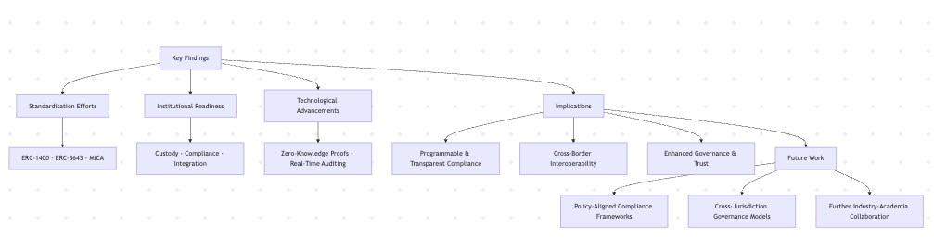

Slide 15
Thank you

